Slide 1
Multi-exposure fusion
Osmosis filtering has been used for image fusion, e.g. face fusion, cultural heritage conservation (multi-modal image fusion)…
Other fusion tasks, like the multi-exposure fusion or the multi-focus fusion may also be solved with osmosis filtering
For multi-exposure fusion, there’s a paper that fuses multiple images in gradient domain by solving the Poisson equation
Paul, Sujoy, Ioana S. Sevcenco, and Panajotis Agathoklis.
"Multi-exposure and multi-focus image fusion in gradient domain."
Journal of Circuits, Systems and Computers (2016)
Notes:
Fusion task also includes: image enhancements, haze removal, multi-spectral image fusion…
Ref: Pixel-level image fusion: A survey of the state of the art

Slide 2
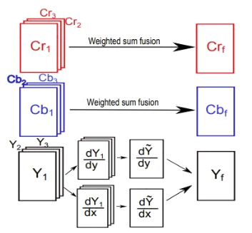
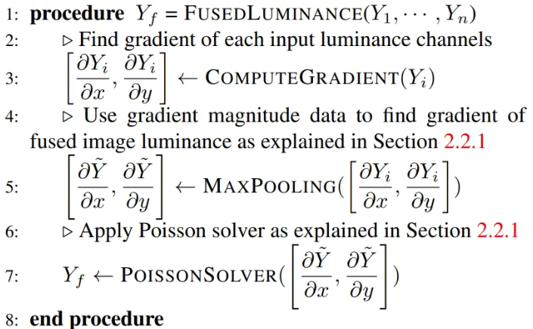
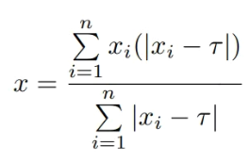
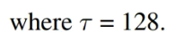
Multi-exposure fusion
Algorithm:
Fusing Y channel with Poisson solver
Fusing Cb/Cr with pixel-wise weighted sum
Post-processing with gamma correction and local histogram equalization
Post-processing is needed since the fused image will have intensity outside standard range

Slide 3
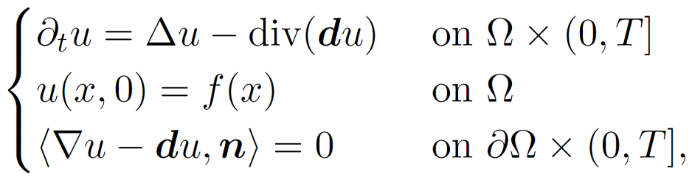
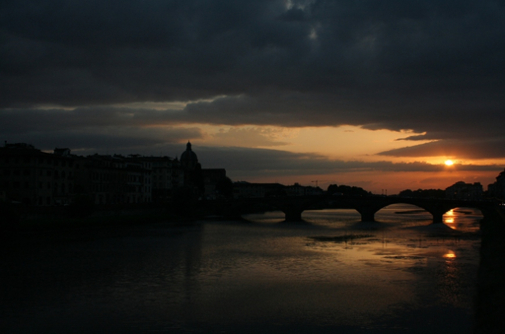
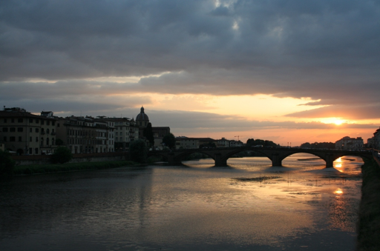
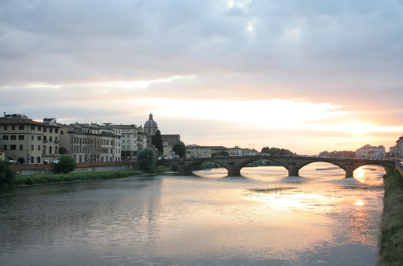
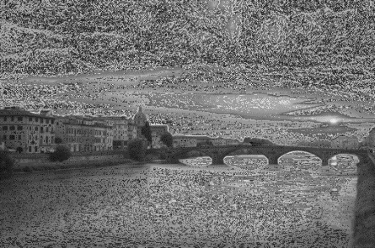
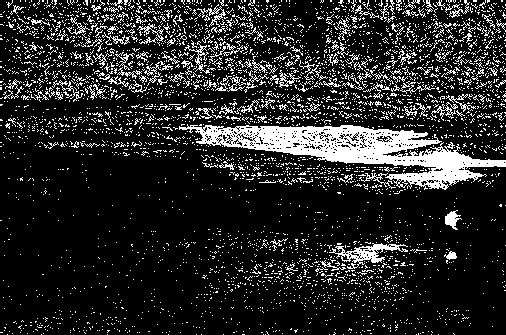
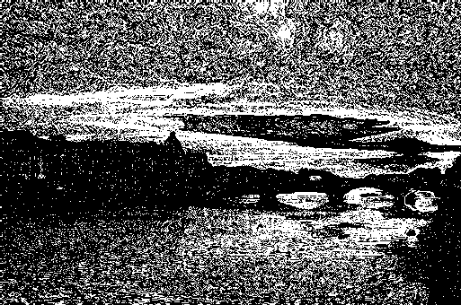
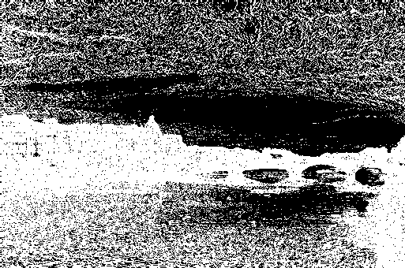
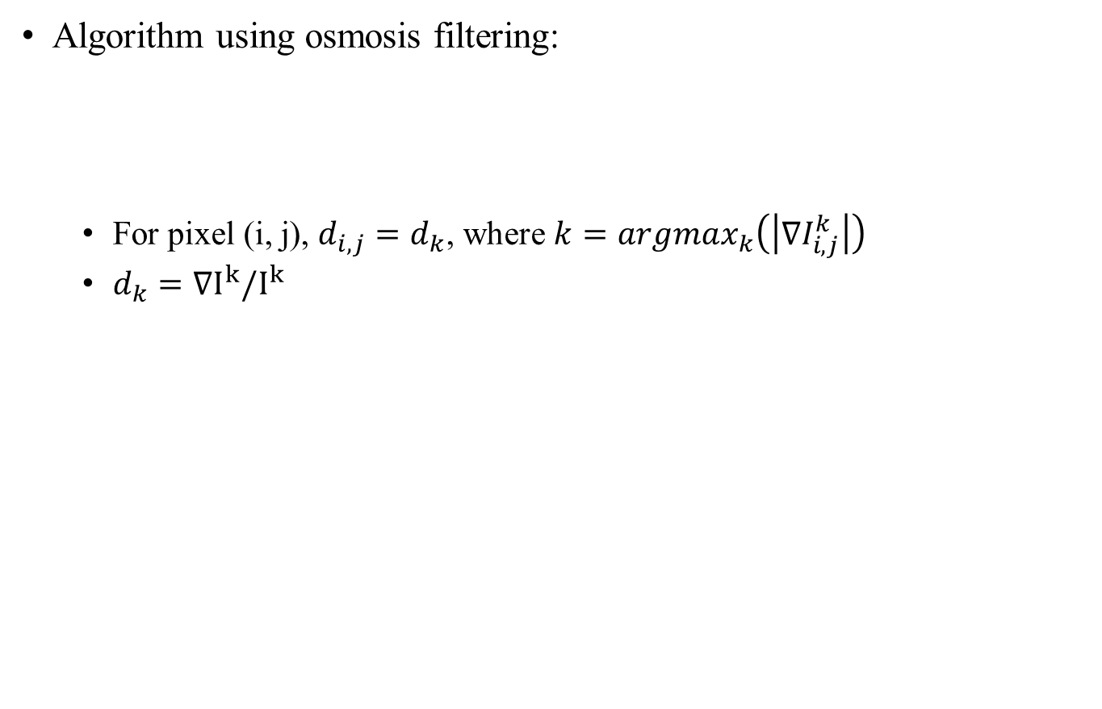
Multi-exposure fusion
Algorithm using osmosis filtering:
For pixel (i, j), $d_{i,j}=d_{k}$, where $k=argmax_{k}\left(\left|∇I_{i, j}^{k}\right|\right)$
$d_{k}=∇I^{k}/I^{k}$
f(x)
Apply Gaussian filter on the weight map can get a smoother result

Slide 4
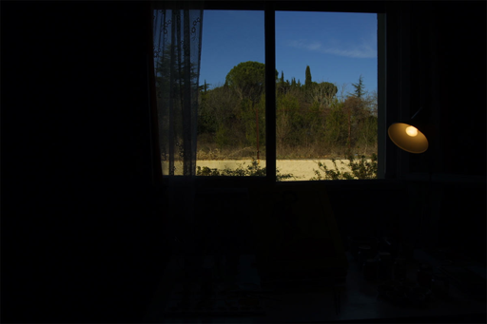
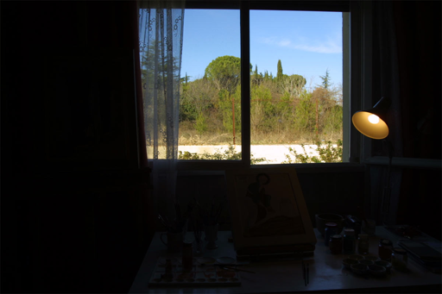
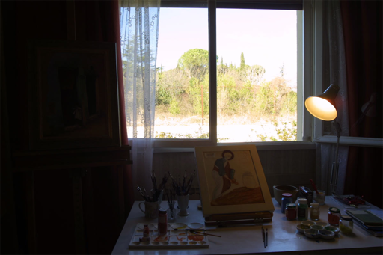
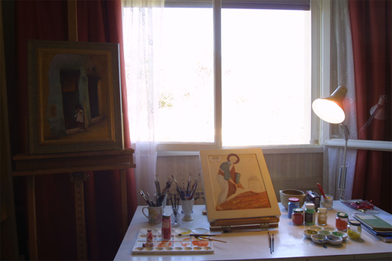
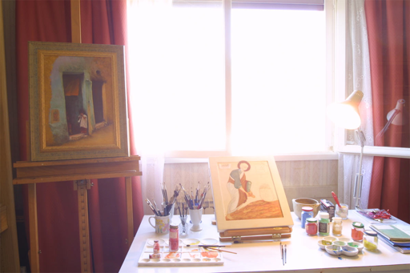
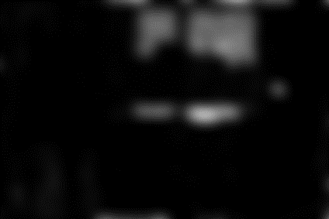
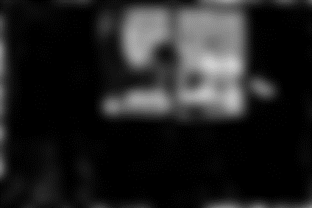
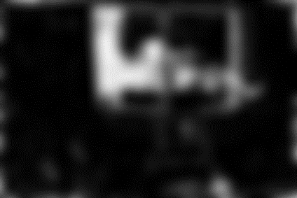
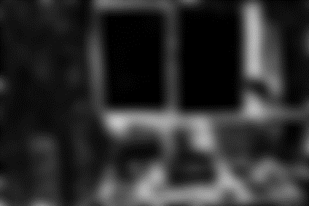
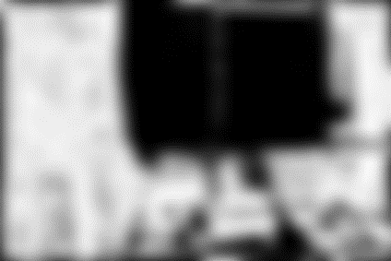
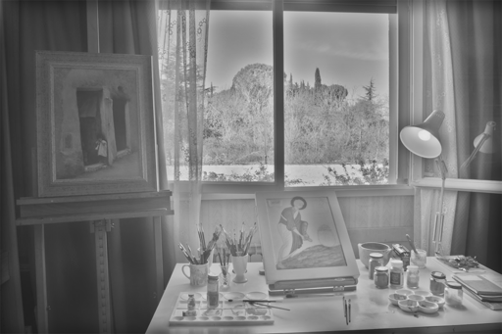
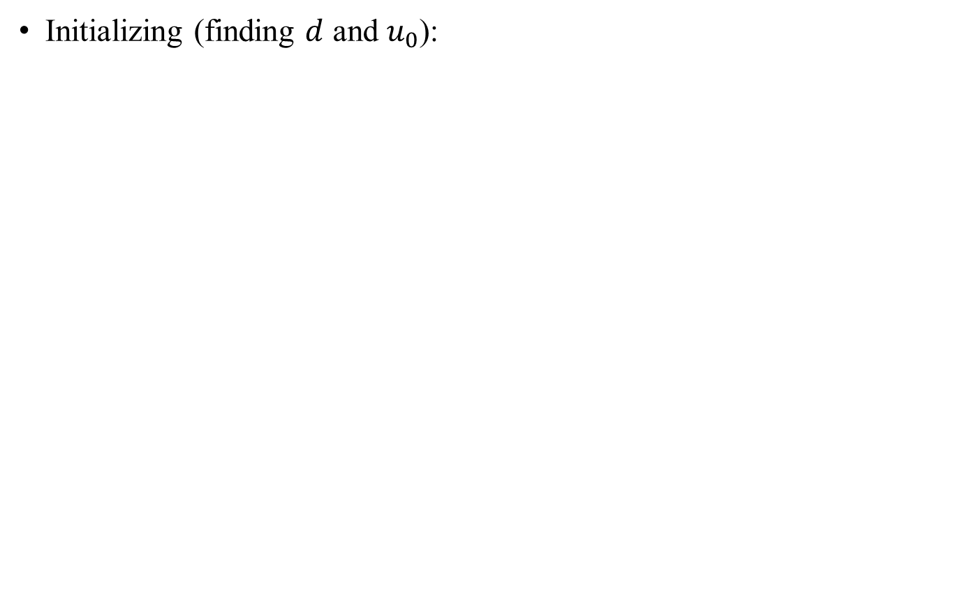
Multi-exposure fusion
Initializing (finding $d$ and $u_{0}$):
Initial solution

Slide 5
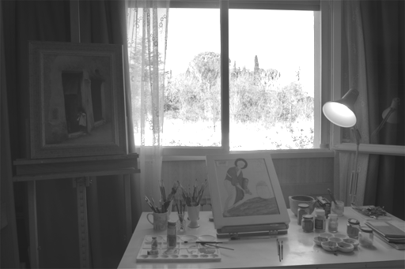
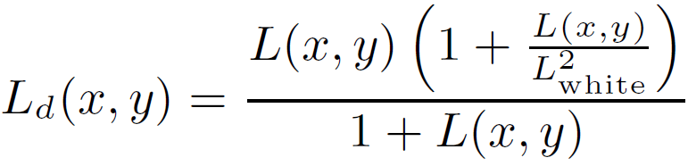
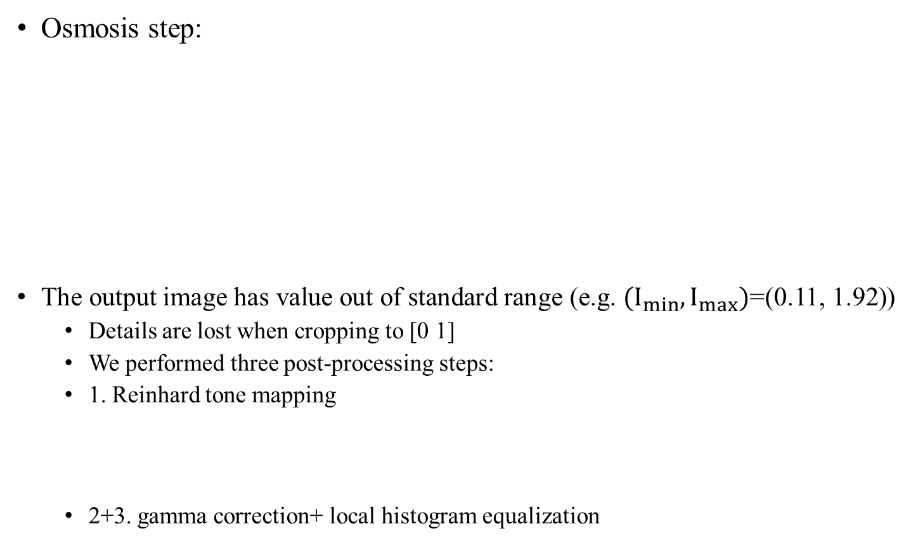
Multi-exposure fusion
Osmosis step:
The output image has value out of standard range (e.g. $(I_{min},I_{max})$=(0.11, 1.92))
Details are lost when cropping to [0 1]
We performed three post-processing steps:
1. Reinhard tone mapping
2+3. gamma correction+ local histogram equalization

Slide 6
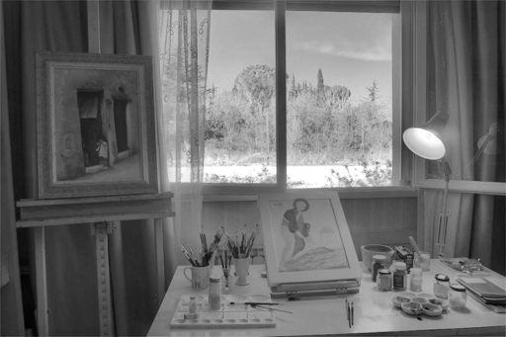
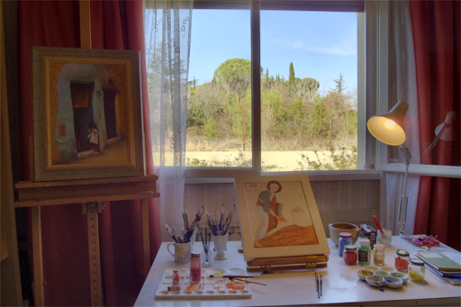
Multi-exposure fusion
Post-processing step:
Full image (recovering Cb and Cr channels):

Slide 7
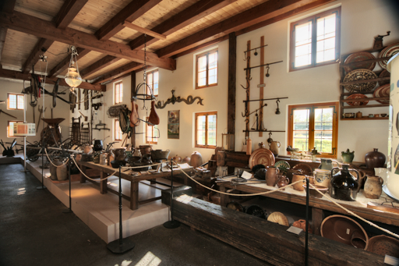
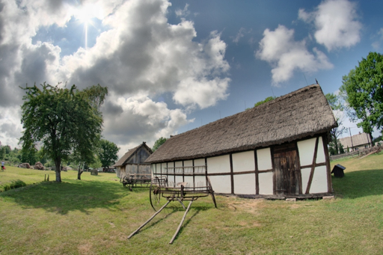
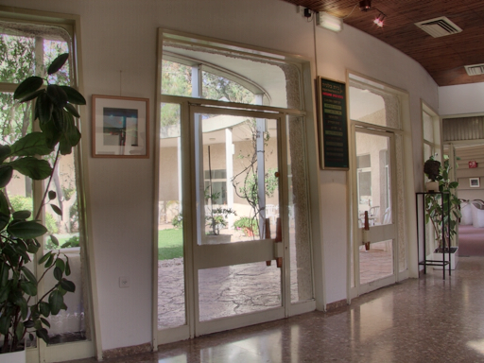
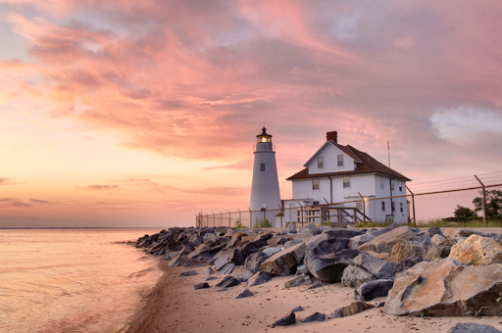
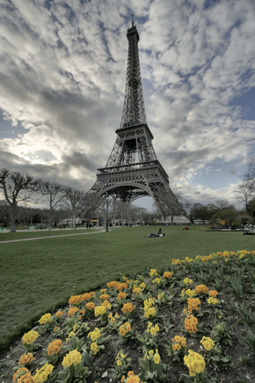
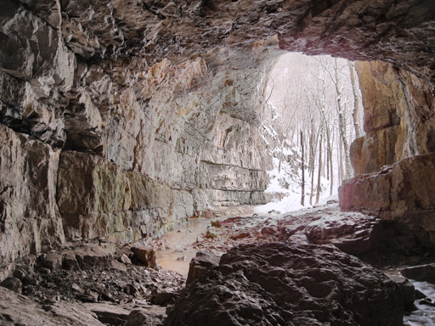
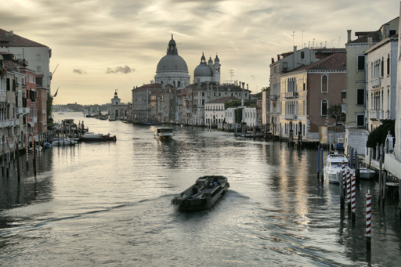
Multi-exposure fusion
Qualitatively results using the osmosis filtering fusion:

Slide 8
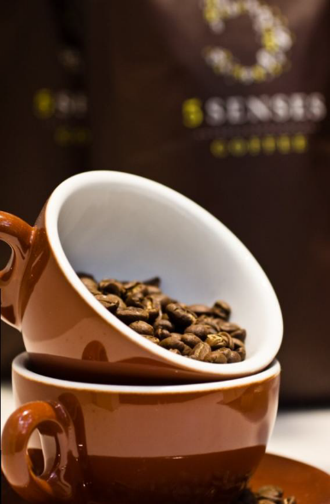
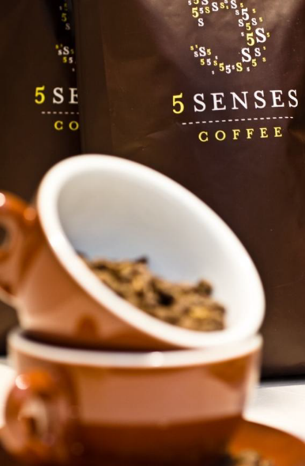
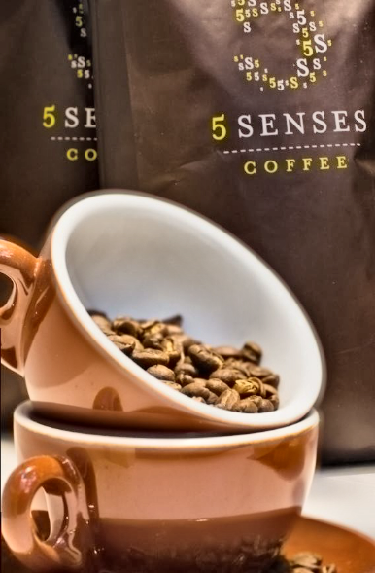
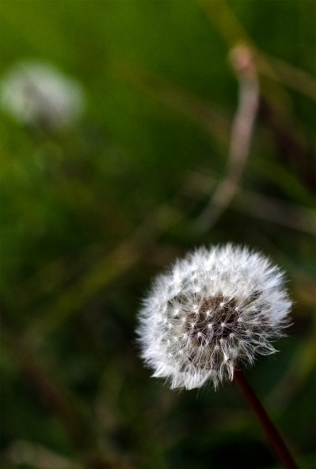
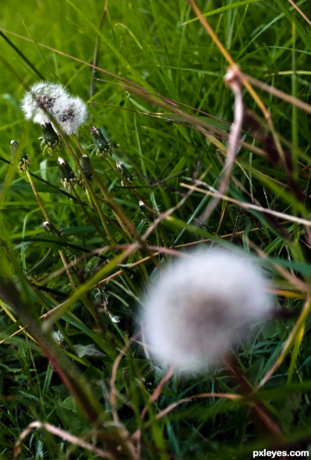
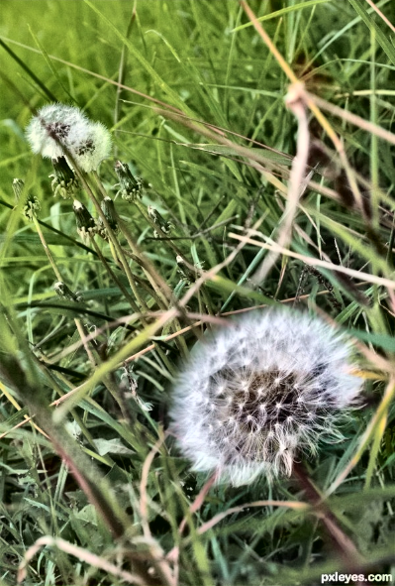
Multi-focus fusion
The same method can also be used for multi-focus fusion:
Inputs
Outputs

